Slide 1

Space Wars
Neil, Rohan & Khushi

Slide 2
RULES:
Use the potentiometer to move your spaceship and press the push button to shoot the asteroids and aliens coming at you
Every asteroid you hit scores you points, the alien spaceships give you 100 points and the asteroids give you 200 points
You have 5 lives and if the obstacles hit your spaceship you lose a life
AIM:
Score the highest number of points

Slide 3
Why should you play Space Wars?
QUICK
UNIQUE HARDWARE COMPONENT
FUN
CHALLENGING
COMPETITIVE
SHARPENS REFLEXES

Slide 4
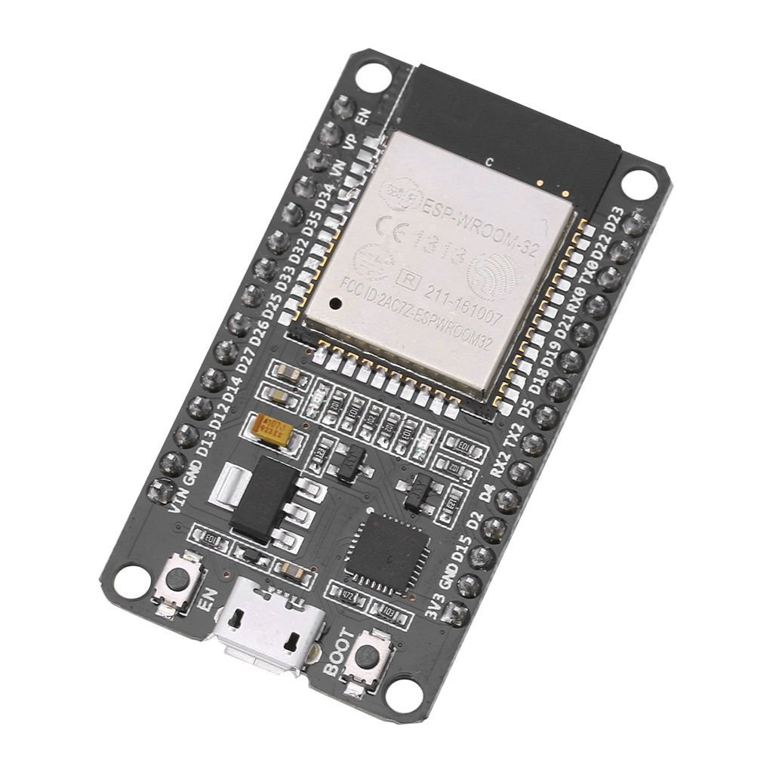
Components and logic used in building the game
ESP32

Slide 5
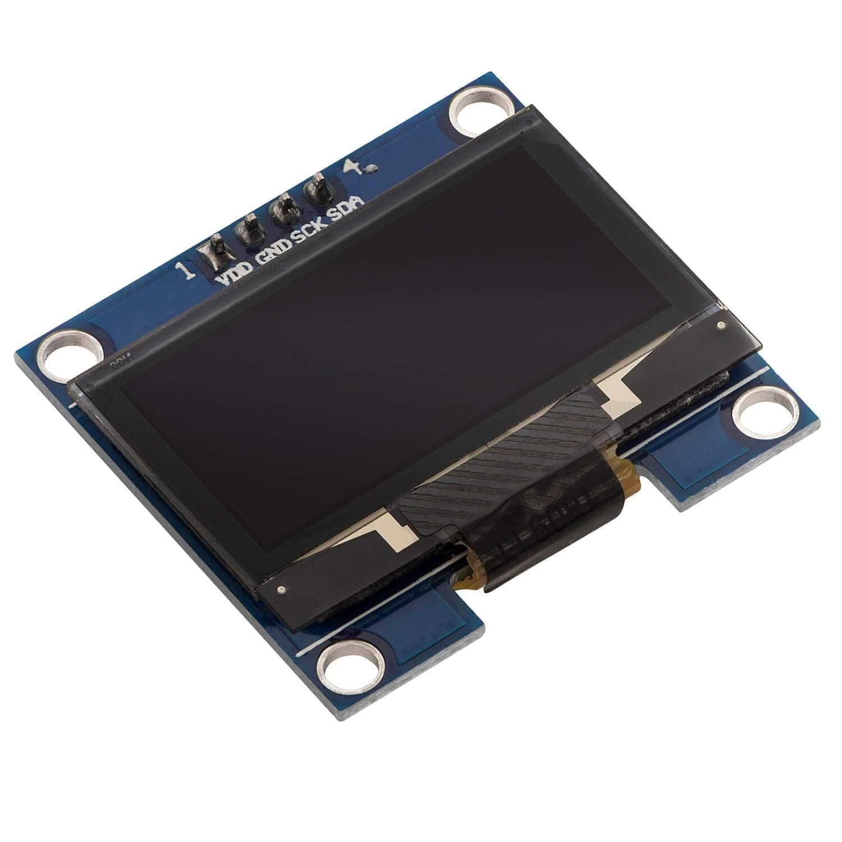
OLED screen

Slide 6
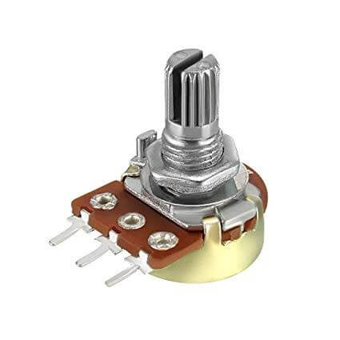
Potentiometer

Slide 7
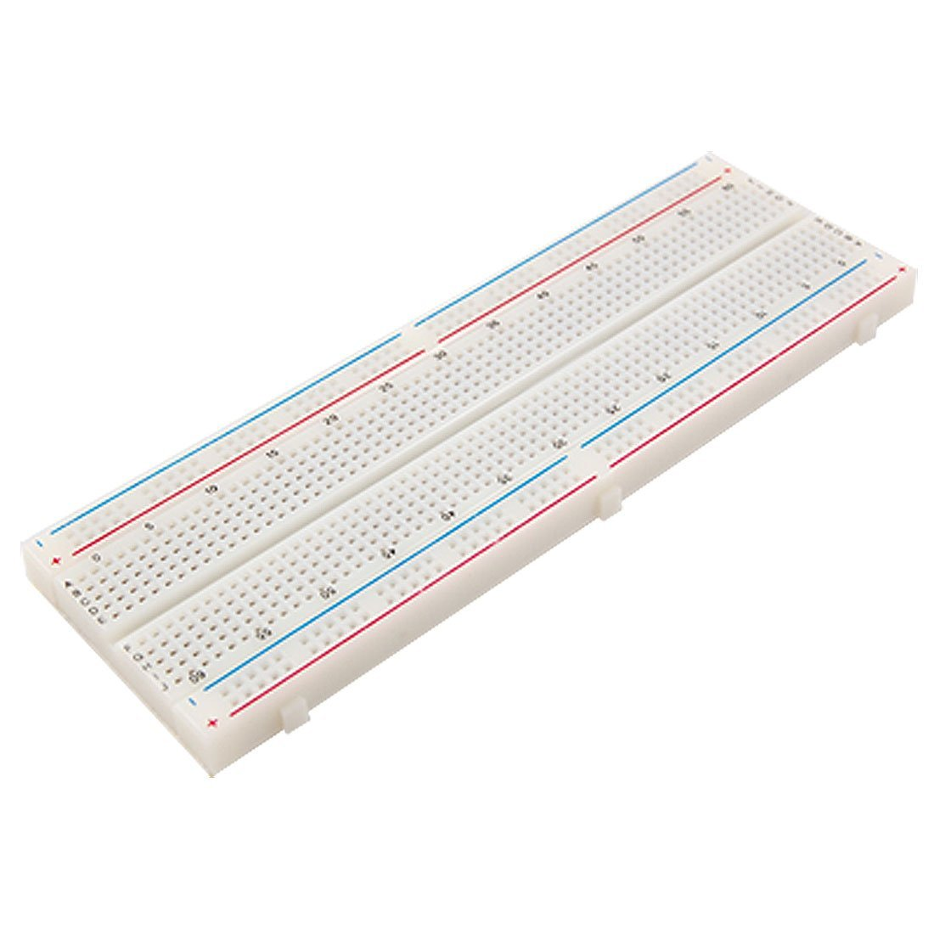
Breadboard

Slide 8
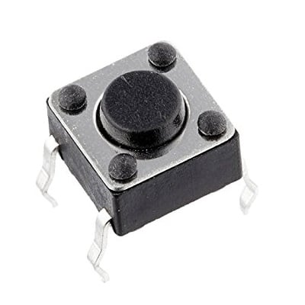
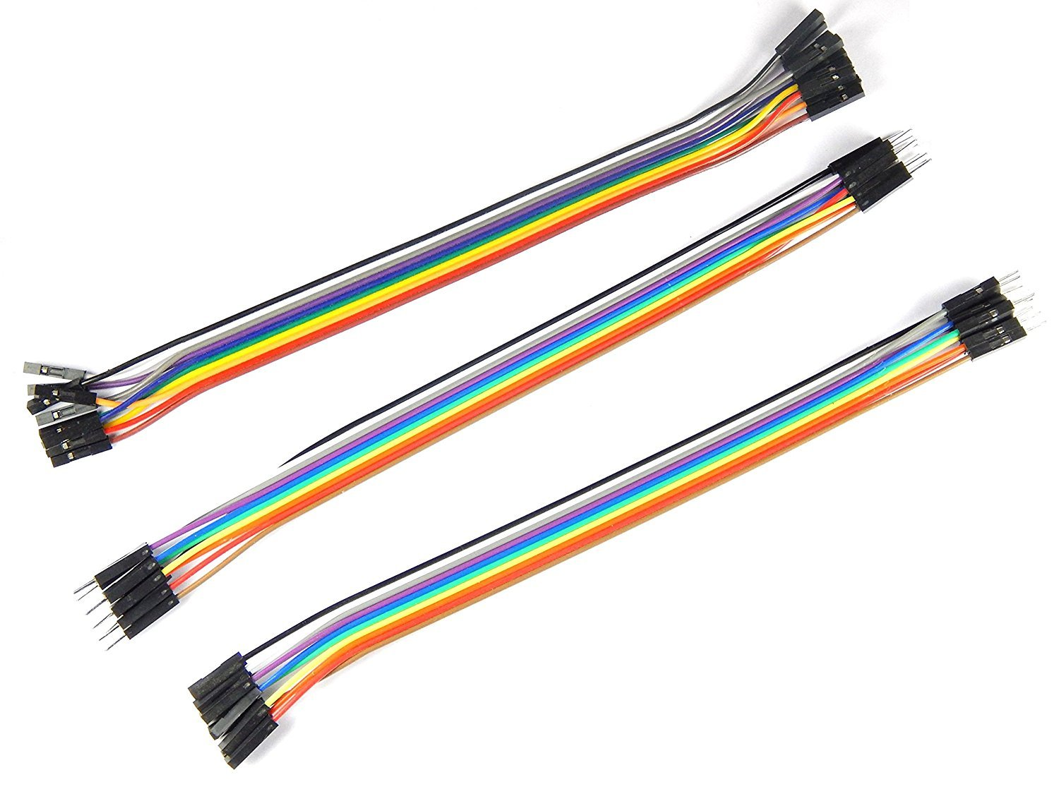
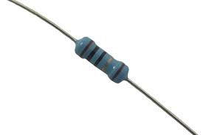
Jumper Cables
Resistor
Push button

Slide 9

Arduino IDE

Slide 10
THANK YOU!

